Slide 1
COVID-19 Pandemic: Possible Evaluation Topics and Criteria for a SAI
INTOSAI Working Group on Evaluation of Public Policies and Programs
Webinar, 7 July 2021 – Emmanuel Sangra

Slide 2
Overview
Programming evaluations at the SFAO
Plenty of topics related to COVID-19
SFAO’s strategy to pick the best topics
Which topics were chosen and why?
Coordination with Parliament and Agencies
Conclusion

Slide 3
1. Programming evaluations at the SFAO
Choosing topics independently is a great privilege, but also a heavy responsibility
3-4 evaluations every year
Topic covering all the Swiss Confederation policies
Five main steps
Matrix organization: Auditing units propose ideas to convince heads of mandate sectors who have to convince the management of SFAO…
Notes:
INTOSAI GOV 9400 The evaluation of public policies is a specific process notably in that it relies on cooperation, sometimes a co-construction of the approach with stakeholders who are actors in the policy, or who are direct or indirect beneficiaries of the actions evaluated, or who simply are affected by this policy. The association of stakeholders is also specific in the sense that what is sought does not only consist in correcting administrative dysfunctions but rather in improving a policy.
often reports recommendations for legislative changes

Slide 4
2. Plenty of topics related to COVID-19…
Public Health measures (prevention, patient care, vaccinations etc.)
Crisis organization and support by the Army and the Civil protection
Financial support to employees, self-employed, artists
Financial support to businesses and organizations (start-ups, sports clubs, cultural organizations etc.)
Indirect consequences of the lockdown (functioning of the public administration, work style, health etc.)
Notes:
A. Patient care, Covid tests, vaccinations, confinements, prevention measures (wearing masks, distancing, hygiene), border restrictions, etc.

Slide 5
3. SFAO’s strategy to pick the best topics
From the outset of the pandemic, the SFAO was much involved in auditing the financial measures linked to COVID-19.
Given the urgency, it adapted its program 2020 and devoted a large part of its resources to examining the decisions of the Government in order to prevent financial errors and to avoid abuses by the beneficiaries of financial aid (using data analysis).
In Summer 2020 before the second wave, the SFAO identified 17 potential topics for the evaluation’s program 2021-2023 and fixed the following priorities:
a. High financial consequences (1-4 points)
b. High risks of problems
c. Advantages of the SFAO over other entities due to its position and competences
d. Chance of implementation of the recommendations (competence of the Confederation and risk of a new crisis)

Slide 6
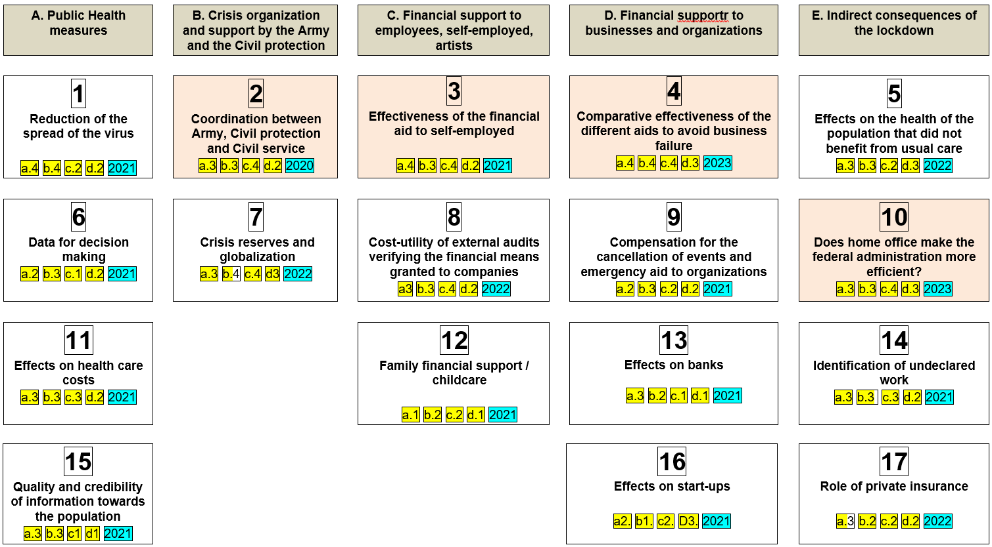
4. Which topics were chosen?

Slide 7
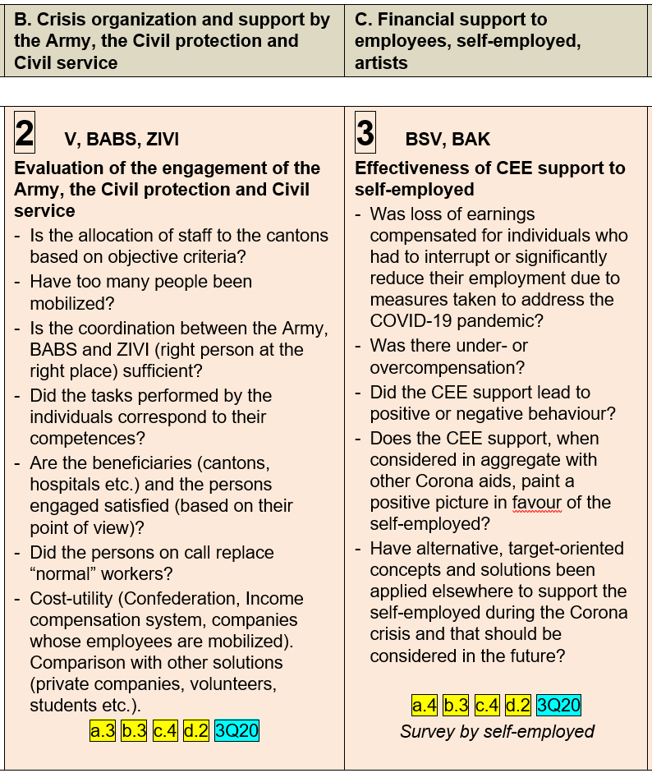
Why these topics were chosen for 2020 and 2021?

Slide 8
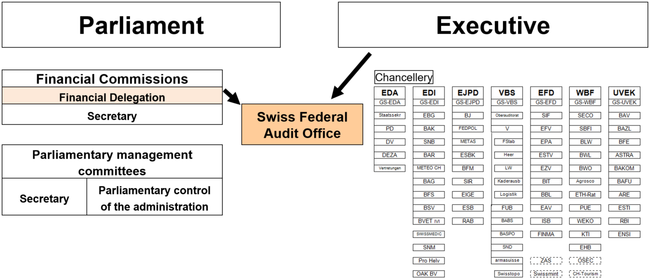
5. Coordination with Parliament and Agencies Take into account evaluations conducted by other entities!
Agencies most directly concerned by COVID-19
Entities used to conducting evaluations
Entities that have decided to produce a published report on their work

Slide 9
6. Conclusion
The theme to be evaluated must be well focused
When choosing the topics, important to consider
The role of agencies and Parliament in evaluating and reporting on Covid 19
The advantages of the SAI over these entities due to its position and competences
Some Covid 19 measures should be evaluated by SAI because of their huge financial and human impacts
But attention - low chances that our recommendations will be implemented… A crisis such as Covid 19 should hopefully remain exceptional!

Slide 10
Thank you for listening! Questions?

